Slide 1
The estrous cycle
Definition
Sexual Puberty in the females is defined as the age at the first expressed estrous with ovulation
Sexual Maturity in the females is defined as the age at the expressed estrous with ovulation and normal parturition

Slide 2
Definition
Estrous cycle : reproductive cycle of female generally defined as period from one estrous to the next . It two phase
1- follicular phase(proestrus and estrus)
2- luteal phase (metestrus and diestrus)
Estrous : period of sexual receptivity commonly referred to as “ heat “
Anestrous : period when female does not have cycles occurring during pregnancy , season , pathology ……………….

Slide 3
Causes of Anestrus
Pregnancy
Season
Pathology
Nutrition
Stress

Slide 4
Proestrus
Estrus
Stage of heat
Metestrus
Diestrus

Slide 5
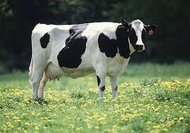
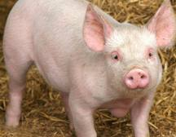
Animals classified according to estrous cycle (TYPES OF ESTROUS CYCLE)
1 - Poly estrous; cow ,sow

Slide 6
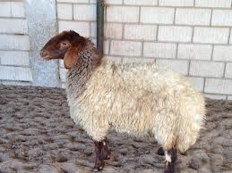
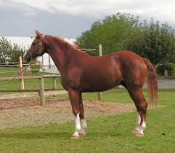
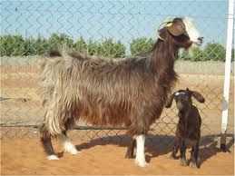
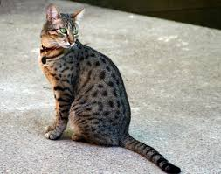
2 - Seasonal poly estrous
A- short day breeder; ewe , doe
B –long day breeder; mare , queen

Slide 7
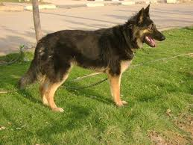
3 – monoestrous; bitch , wild animals

Slide 8
Hypothalamus
Progesterone
Estradiol
(+)
(-)
GnRH
Anterior
Pituitary
LH, FSH
Inhibin (-)
Estradiol
LH
LH, FSH
CL
Follicle
Ovary

Slide 9
Average Reproductive Cycles
Species Length of Length of Ovulation Length of
Estrous Cycle Estrus Pregnancy
cow 21 days 18 hr 11 hr after 282 days
polyestrus end estrus
ewe 17 days 29 hr near end 148 days
seasonal estrus
sow 21 days 48-72 hr 35-45 hr 115 days
polyestrus after start
estrus
mare 21 days 4-8 days 3-6 day of 335 days
seasonal estrus
polyestrus (1-2 days
before end of
estrus)
Doe 21 days 30-40 hrs few hrs after 149 days
seasonal ovulation

Slide 10
Characteristics of Estrous Cycles
Cow Ewe Sow Mare
Estrous cycle (days) 21 17 21 21
Proestrus (days) 3-4 2-3 3-4 2-3
Estrus 12-18 hr 24-36 hr 48-72 hr 4-8 days
Metestrus (days) 3-4 2-3 2-3 2-3
Diestrus (days) 10-14 10-12 11-13 10-12

Slide 11
Signs of Estrus
Primary Sign of Estrus
Stands immobile when mounted.
Bellowing
Red vulva
Swollen vulva
Clear mucus discharge from vulva

Slide 12
Secondary Signs of Estrus
Behavioral
Increased Activity
Charging
Licking
Sniffing
Chin-resting
Mounting

Slide 13
Miscellaneous Signs of Estrus
Depressed appetite
Depressed milk production
Frequent Urination

Slide 14
During rectal palpation
Uterus is turgid
Presence of GF

Slide 15
Ovary - CL and Follicle
Graafian
Follicle
Corpus
Luteum
Tertiary Follicles

Slide 16
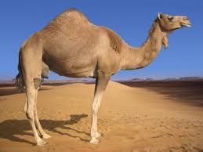
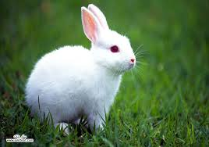
Animals induced ovulation

Slide 17
Spontaneous Ovulators
Retain some neural control of ovulation
heifers can alter the timing of the LH surge by clitoral stimulation

Slide 18
Induced Ovulators
Nerve endings sensing copulation
Sensory Neurons
Copulation
Penis

Slide 19
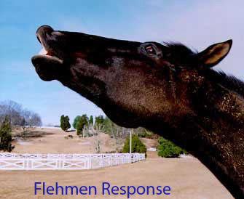

Slide 20
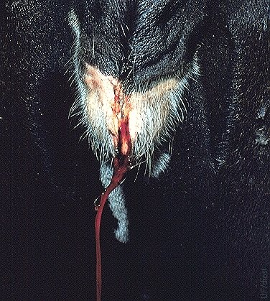
Met estrous Bleeding

